Slide 1
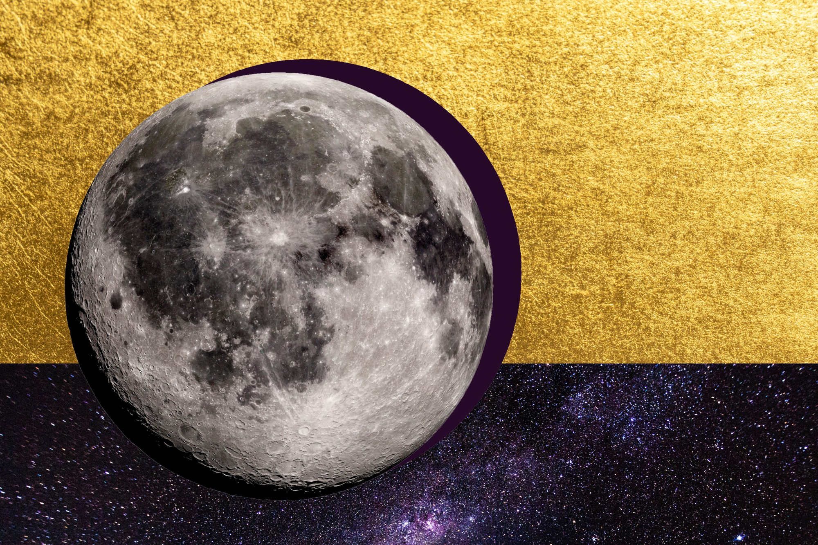
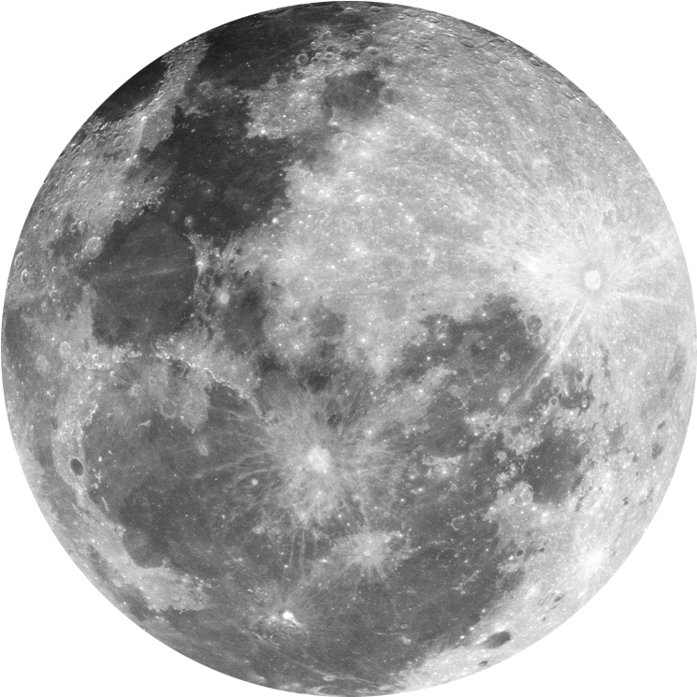
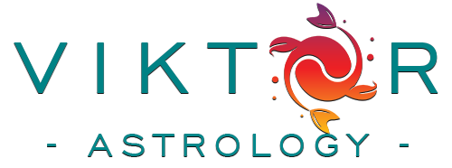
Aspect
Masterclass
LESSON 6

Slide 2
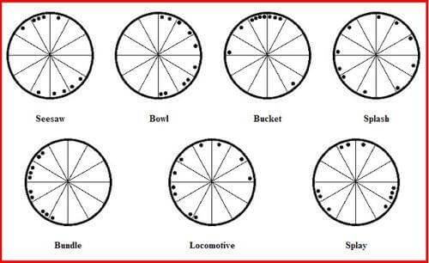
Chart shapes
Seesaw
Bowl
Bucket
Splash
Bundle
Locomotive
Splay

Slide 3
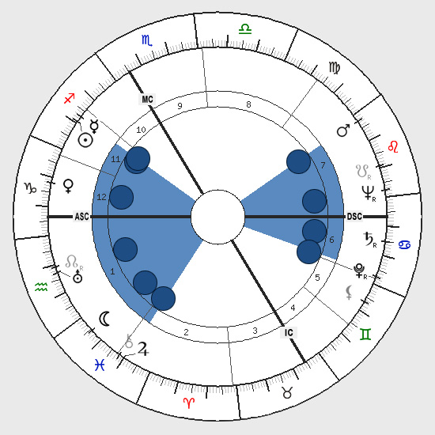
Seesaw
2 opposing groups
Being pulled in 2 different directions
Native needs to learn how to compromise
Being a mediator
Duality
Tendency to solve conflicts
Great negotiators
Living 2 lives
Strong need for romance

Slide 4
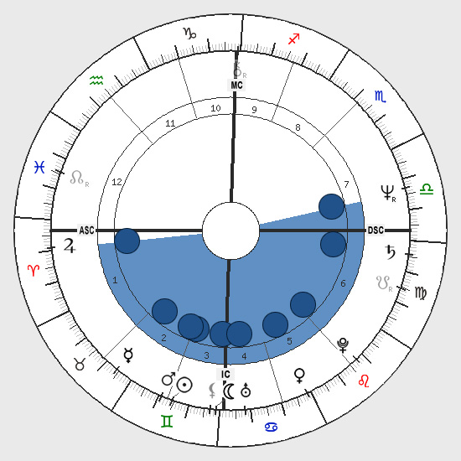
Bowl
All planets occupy half of the chart (for example 4-9th house) - within 180 degree
Feeling empty
Finding something or a partner who will balance you out
The planets on the edge are the contact themes with the missing world
Me and the rest of the world
Success where the planets are, the rest is missing, "the other half"
Looking for something which makes them complete
Platonic love
They cannot be without a relationship
Obsession relates to the boundry planets (key to become complete too)

Slide 5
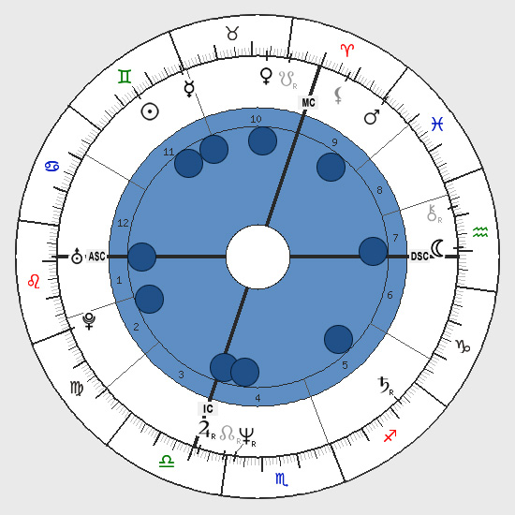
Splash
Planets are splashed all throughout the chart
Diverse interest
Easily scattered
Jack of all trades
Versatile
No boundries between me and others
No clue what direction they want to pursue
Desire for independancy

Slide 6
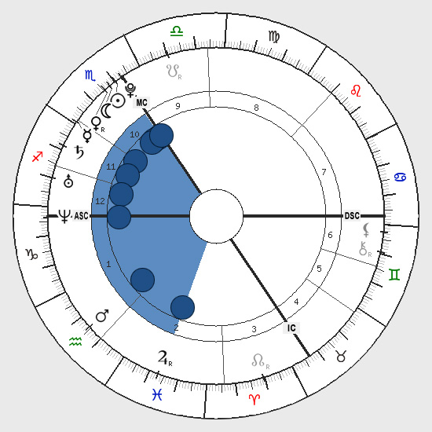
Bundle
Planets are crumbled in 4 zodiac signs
Extreme focus on one part of life
Obsessive
Very talented, but need to be able to focus on other parts of chart too
Superhero
Exaggeration (psychological inflation)
Risk takers
Winners / losers

Slide 7
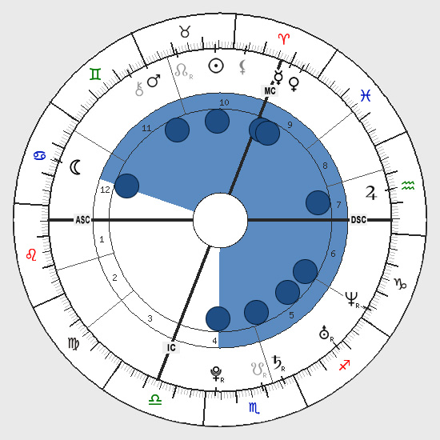
Locomotive
Planets occupy 2/3 of the entire chart (9 houses out of 12)
3 houses are unexpressed area
Working harder to achieve in those houses
Like to leave a stamp on the world
Moving forward
Restless,full of energy
First planet in the clockwise direction - pulls the coaches (determines goals and the nature of dynamics)
Last coach (planet) suffers the most

Slide 8
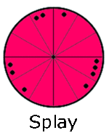
Splay
Planets are concentrated in a fee area of chart (like 3 stellium)
Strong interests in those areas
Could be successful in those areas

Slide 9
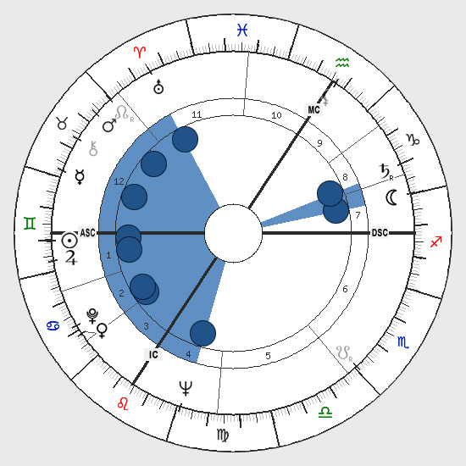
Bucket
Most planets are on one side (bowl) and a singleton planet on the other side.
The handle shows where the person confronts or manifest the most
Point that holds native's life together
Conflict / crisis or plenty of effort to avoid
Luna singleton - home, family, nutrition, care for soul, the public
Saturn singleton - structure, administration, law, office, justice, authority
Jupiter - expansion, philosophy, spirituality, business, adventure, education, travel
Mars - sport, fight, vitality, life force
This is the shape of extreme

Slide 10
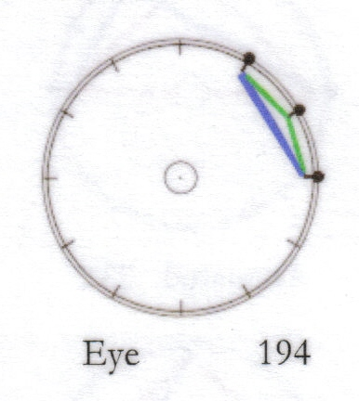
Aspect shapes
The Eye
This figure consists of two semi-sextile aspects (30 deg) and one sextile aspect (60 deg)
Intuitive, eagle-eyed, observant
6th sense in those houses it takes place
Clairvoyance
6th sense

Slide 11
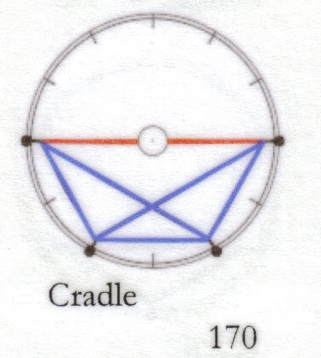
The cradle
1 opposition, 3 sextile, 2 trine
Also called as Half Hexagon, as it looks like a Grand Hexagon( Grand Sextile)
Receptive of masculine vs feminine
This is the person who longs to make a life a cradle where they can snuggle up and shut off the rest of the world
If the Cradle is at the top of the birth chart, or at either the Ascendant or Descendant side, it will of course always tip them out of the false security they constantly try to recreate. They are trying to escape from the true realities of life by snugly caring for themselves &/or others people
Escaping from realities
Loads of talent indicated here, the person soaks up the pain of other people, but when others try to get close to them, then opposition switches on. REAL EMPATH

Slide 12
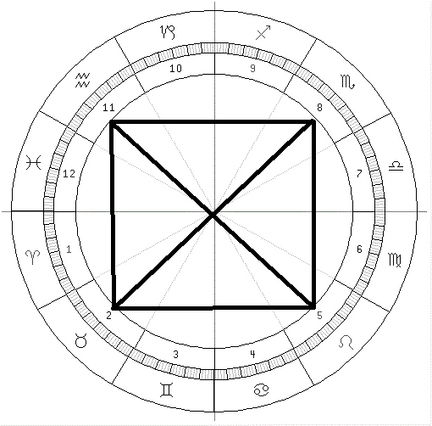
Grand cross
-The Grand Cross consists of four planets connected by four squares and two oppositions. In effect this consists of four 'T' Squares and, although the process of interpretation is essentially the same as that for a 'T' Square, the complexity and possibilities are considerably more varied. This pattern is not necessarily more dynamic than the T' Square.
In a Grand Cross, there is one planet in each astrological element, but all the planets are in signs of the same modality or quality.
This pulls the native in many directions, ultimately leading to indecisiveness and an inability to produce concrete achievements.
Cardinal Signs, problems and difficulties are more likely to result in energetic and assertive behaviour. the individual wants to accomplish everything at the same time.
problems in retaining the concentration needed to accomplish tasks
Fixed Signs, people may hang on to their problems and be exceptionally stubborn and resistant to change. A fixed Grand Cross is said to lead to a person who is well organized but does not know where to direct their talents. Consequently, those with a fixed grand cross tend to be stuck in the same place.
Mutable Signs, they may be very adaptable but may also exacerbate their problems by evading them.

Slide 13
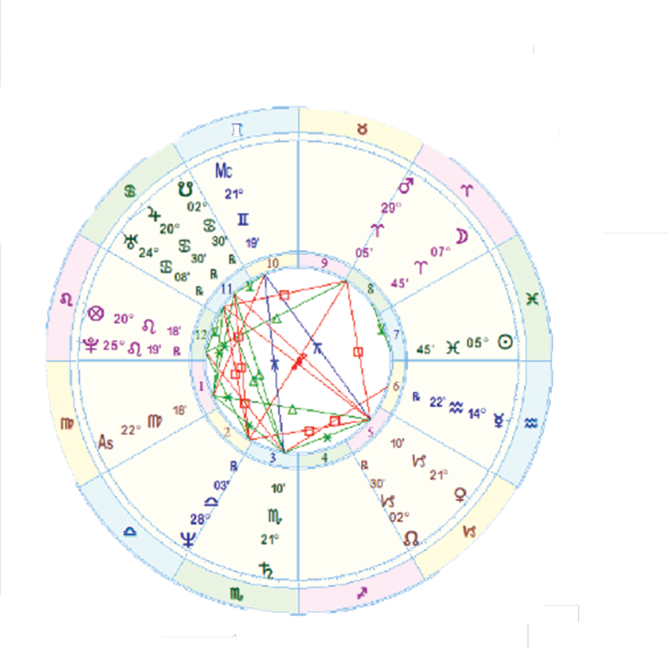

Grand cross
STEVE JOBS

Slide 14
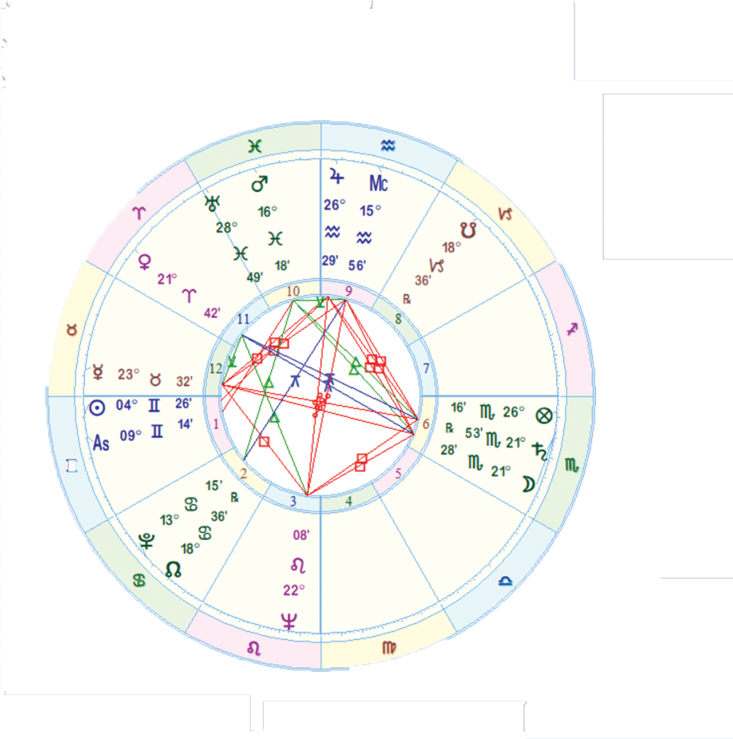
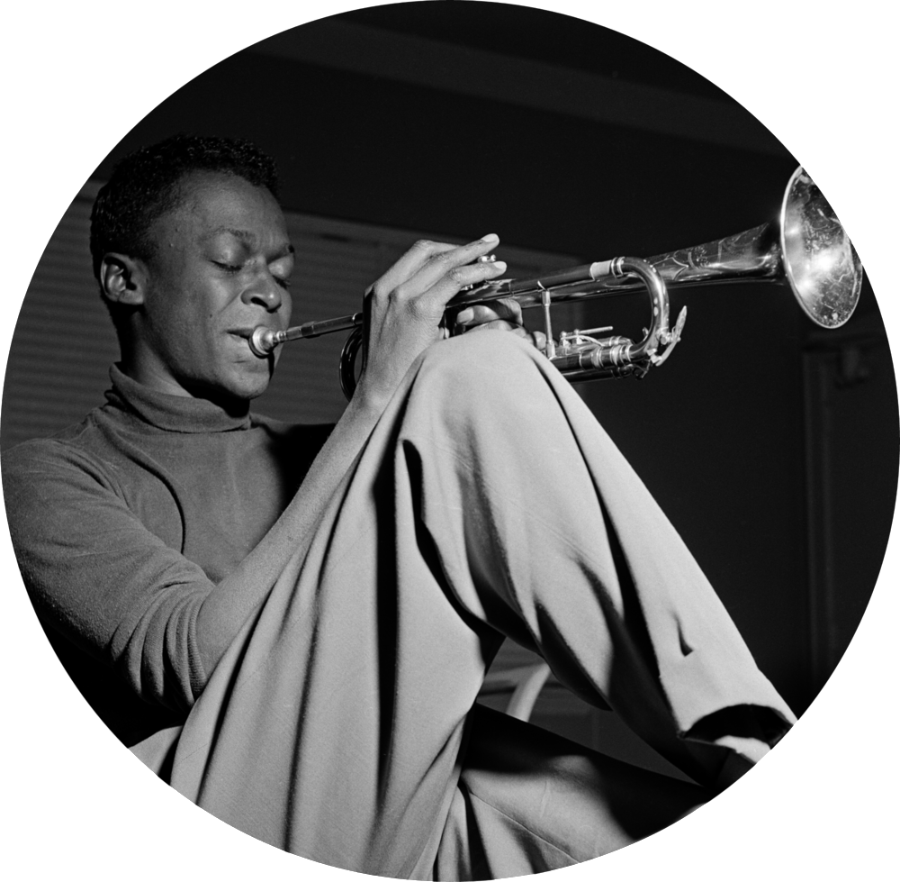
Grand cross
MILES DAVIS

Slide 15
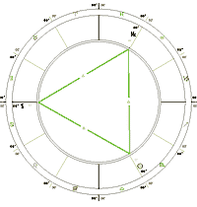
Grand trine
Three planets are connected by three trines to form a triangle, the Grand Trine, around which planetary influences circulate with ease. This brings a wealth of natural talent indicated by the signs and houses containing the planets, but may require tense aspects to provide the motivation for its expression.
Fire Signs, talents lie in enthusiasm, and the search for new possibilities.
Earth Signs, talents lie in practical work and experience.
Air Signs, talents lie in intellectual work and the communication of ideas.
Water Signs, talents are rooted in sympathy, compassion and intuition.
Cím: Fénykép, készítette: Ismeretlen a készítő, licenc: CC BY-NC-ND

Slide 16
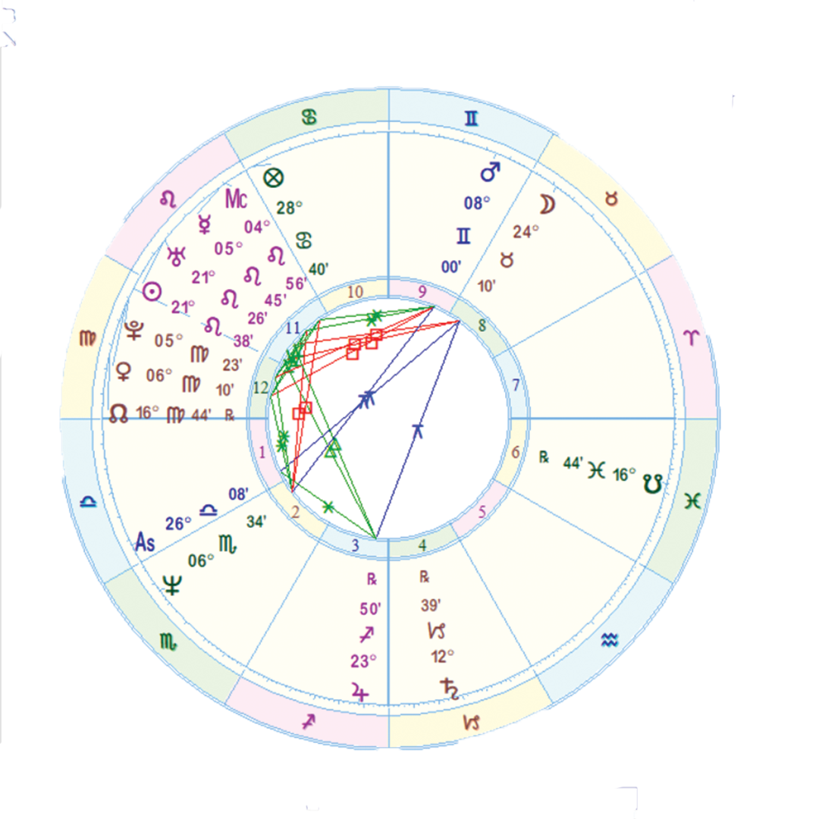
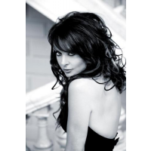
Grant Trine ex:
SARAH BRITHMAN

Slide 17
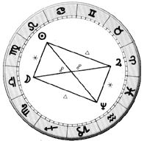
Mystic rectangle
This consists of four planets connected in a rectangle of two sextiles and two trines, together with two oppositions connecting the opposite planets. Despite the name there is nothing mystical about this pattern. The combination of tense and harmonious aspects produces the best possible potential for the constructive use of natural talents.
Same polarity and element.
Key: balance
Air + fire – extravert personality
Earth + Water – introvert personality
Opposition causes out of balance
Sextile + trines – unify those energies
Someone with a Mystic Rectangle in their chart will feel the effects of four planets working together in a strongly balanced and integrated pattern

Slide 18
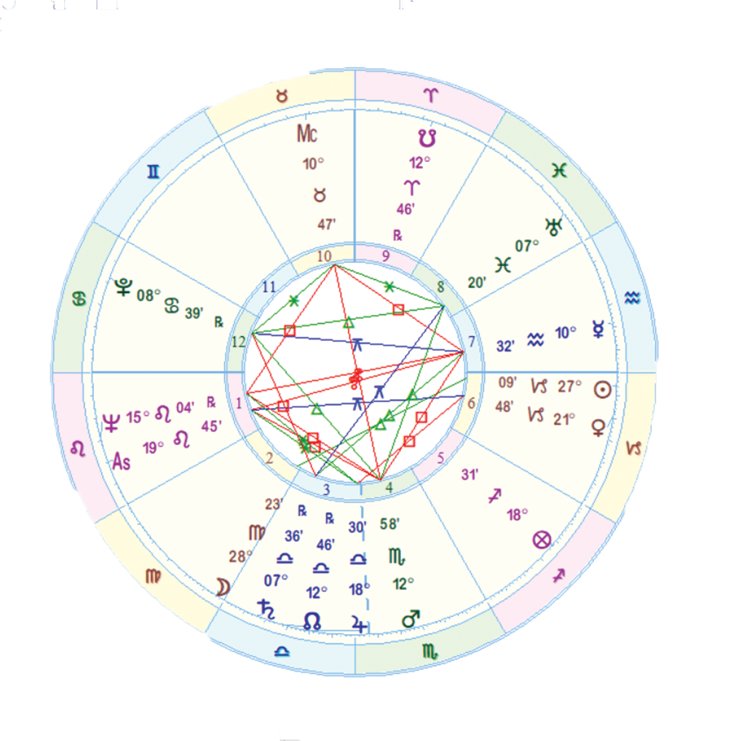
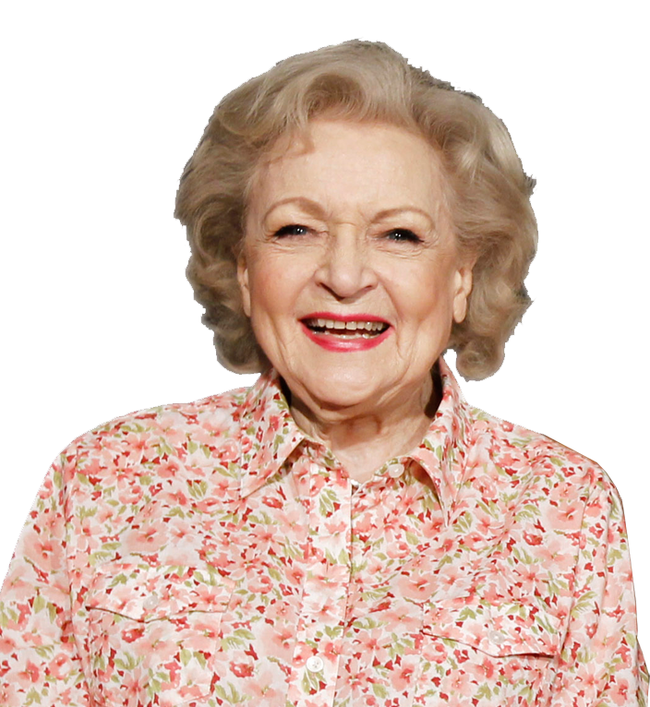
RECTANGLE EXAMPLE
BETTY WHITE

Slide 19
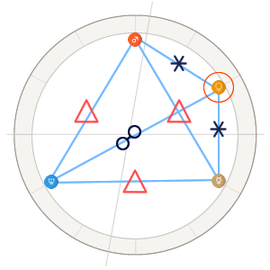
Kite
The person with a kite pattern may be a 'high flyer'.
All three planets in a grand trine are connected to a fourth planet, one by an opposition and the other two by sextiles.
This is useful combination of tense and harmonious aspects in which the two planets connected by trines and sextiles provide outlets for the tension of the opposition.

Slide 20
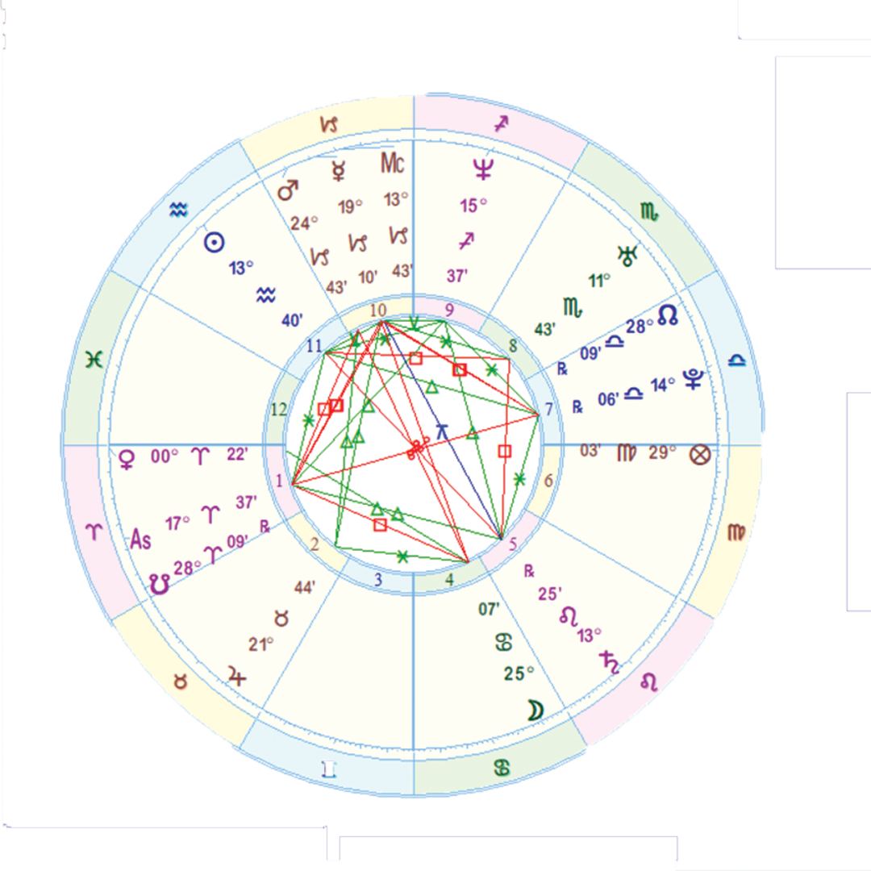
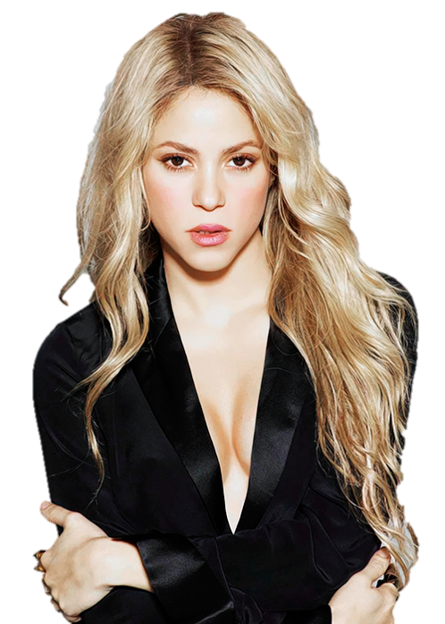
FIXED T - SQUARE
SHAKIRA

Slide 21
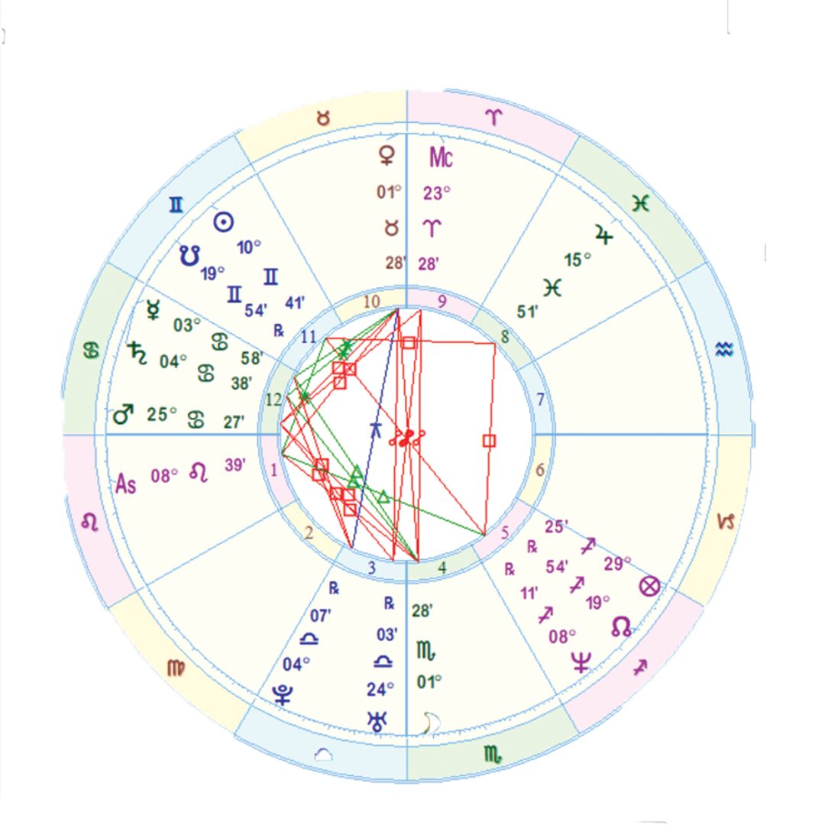
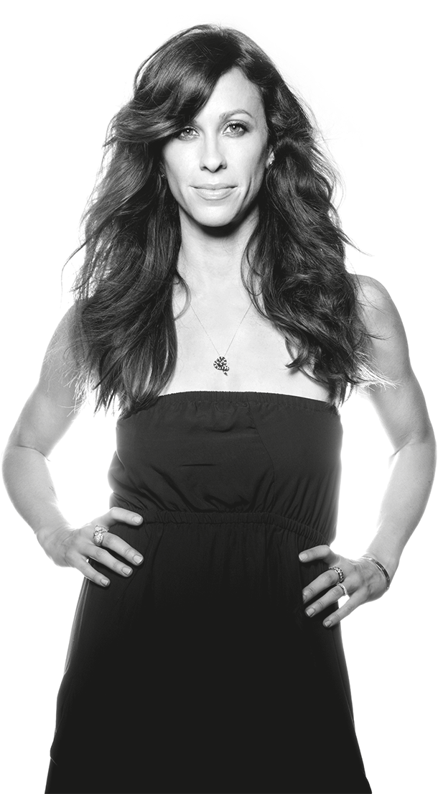
MUTABLE T-SQUARE
ALANIS MORISSETTE

Slide 22
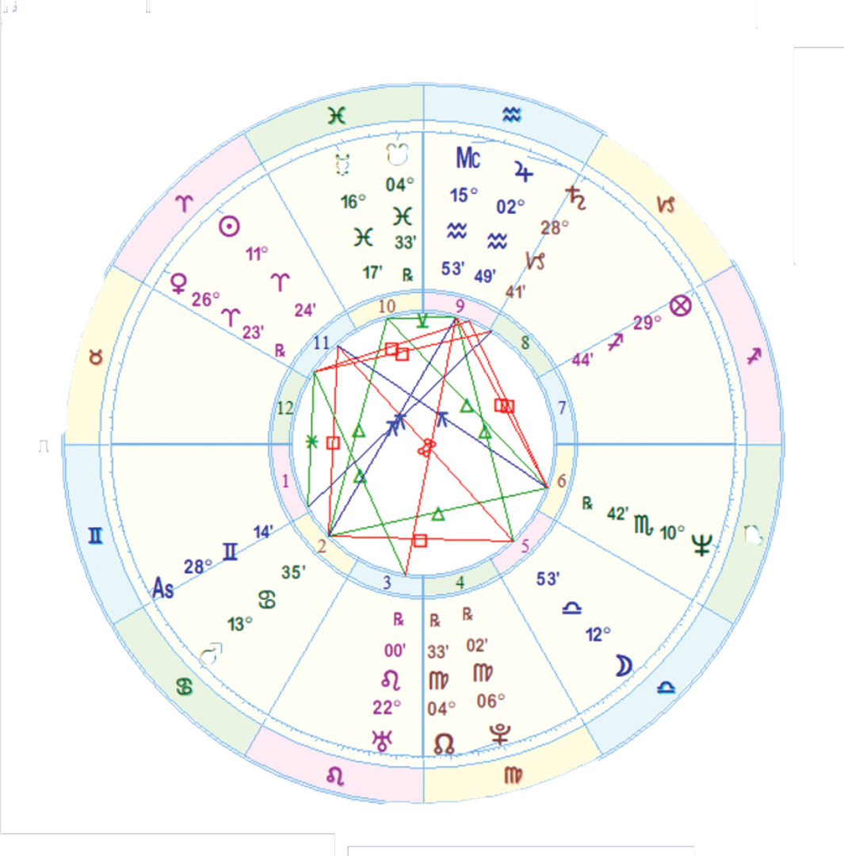
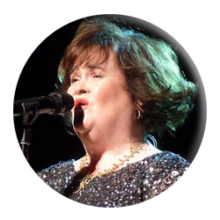
CARDINAL T-SQUARE
SUSAN BOYLE

Slide 23
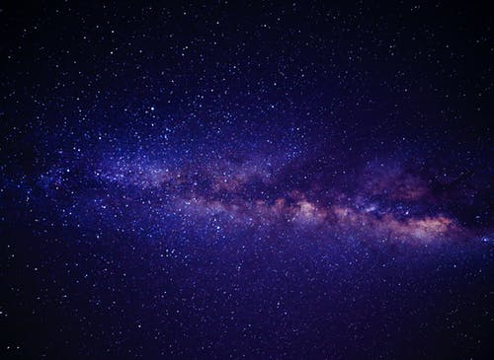
- THANK YOU -

